Slide 1
Advanced MVC

Slide 2
CRUD
Create
Read
Update
Delete

Slide 3
Everything we have done so far is READ

Slide 4
Create
Adding new events to the table

Slide 5
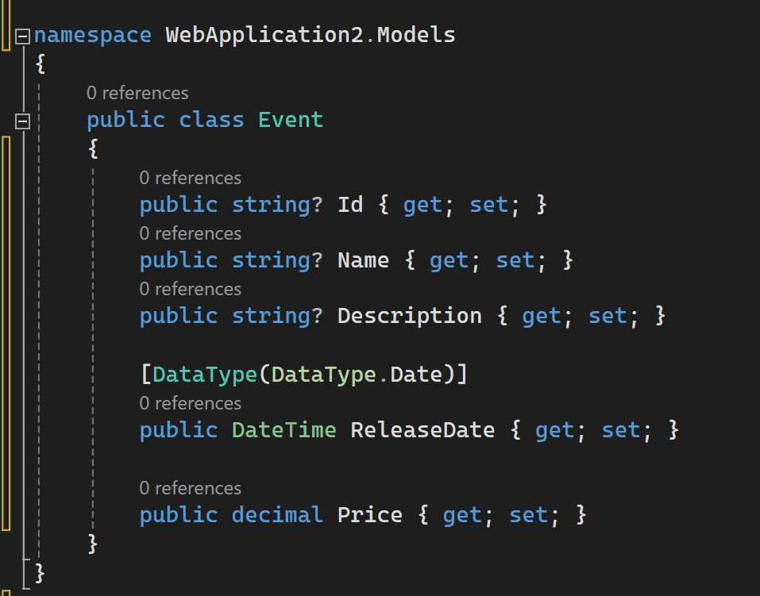
Event Model

Slide 6
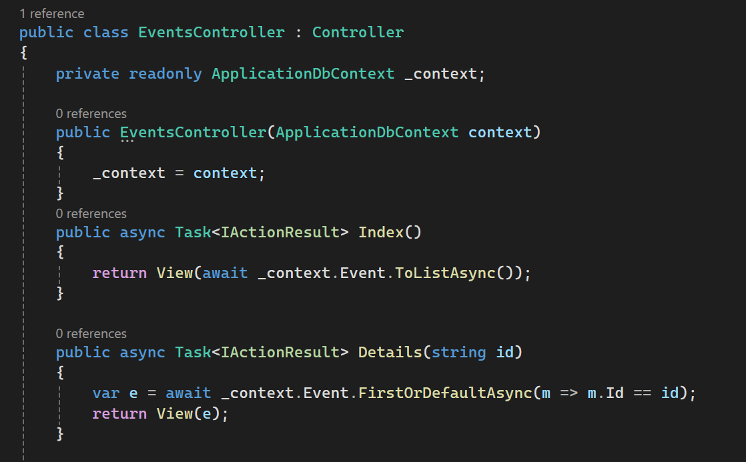
Current Event Controller

Slide 7
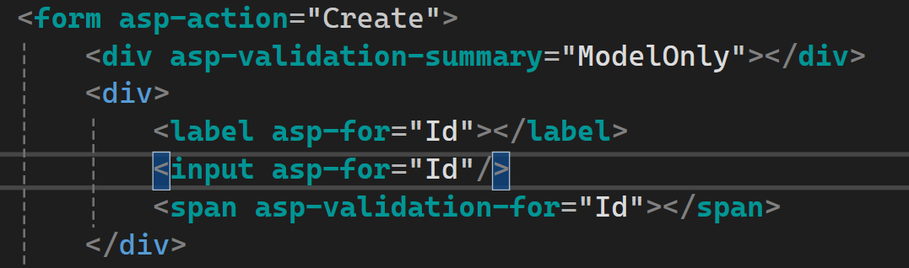
Creating the Form

Slide 8
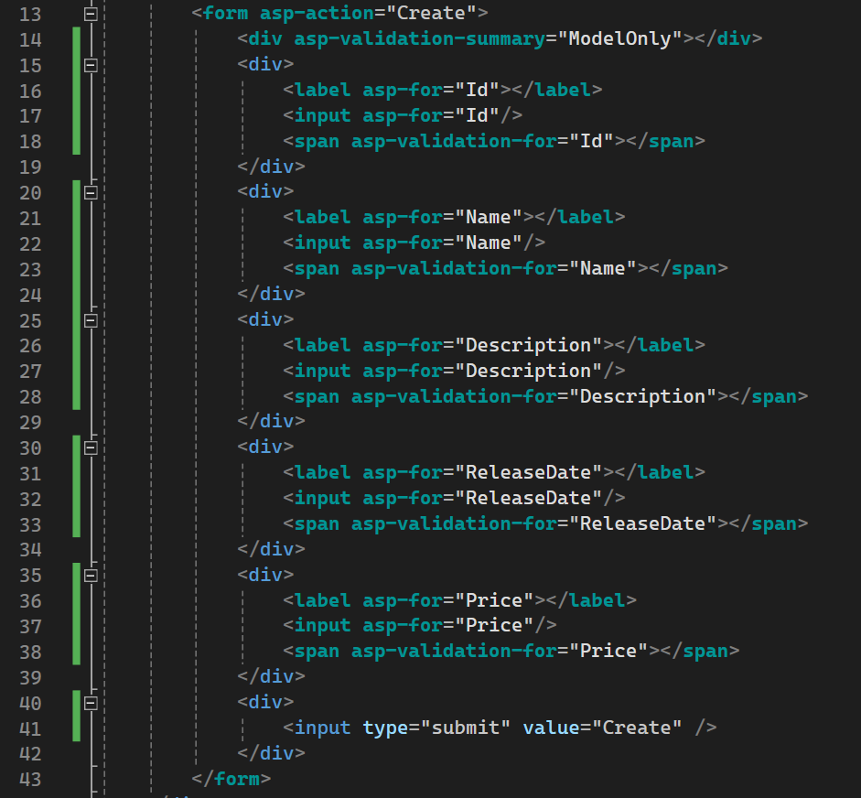
Completed Form Code

Slide 9
Additional Code

Slide 10
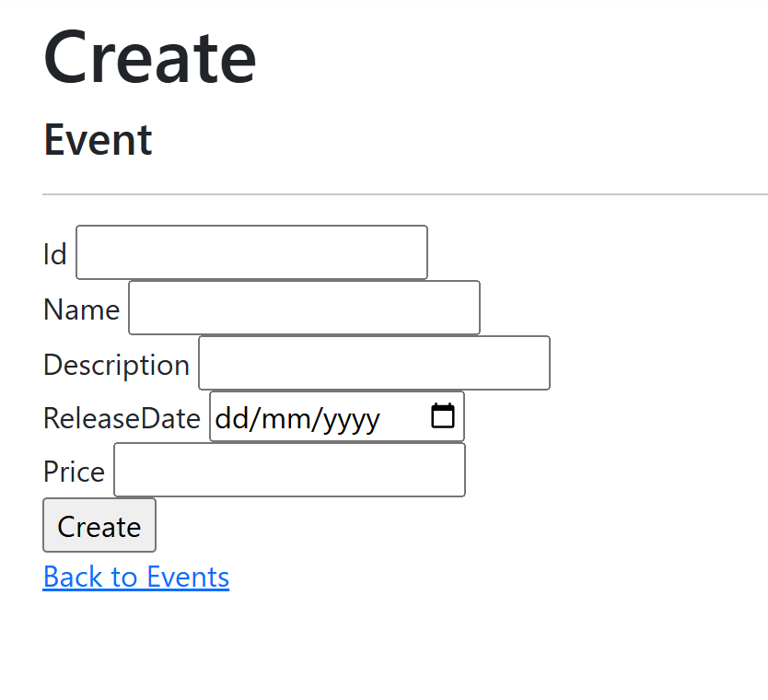
The Form

Slide 11
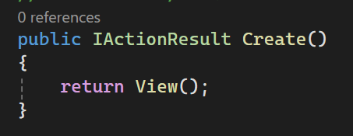
Creating the endpoint

Slide 12
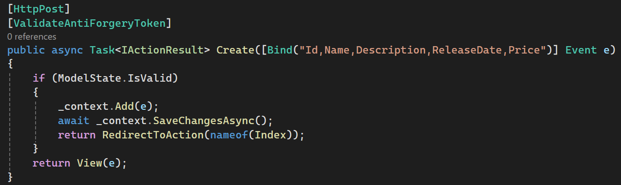
Now creating a POST method in the controller

